Slide 1
Brownian motion
Brian O’Meara
http://www.brianomeara.info

Slide 2
Central limit theorem
The sum of a set of independent and identically-distributed random variates that come from an arbitrary probability distribution function with finite mean and variance approaches a normal distribution

Slide 3
Central limit theorem
The sum of a set of independent and identically-distributed random variates that come from an arbitrary probability distribution function with finite mean and variance approaches a normal distribution
Notes:
iid: what does this mean?

Slide 4
Central limit theorem
The sum of a set of independent and identically-distributed random variates that come from an arbitrary probability distribution function with finite mean and variance approaches a normal distribution
Notes:
what does this mean?

Slide 5
Central limit theorem
The sum of a set of independent and identically-distributed random variates that come from an arbitrary probability distribution function with finite mean and variance approaches a normal distribution
Notes:
Pick a distribution, almost any distribution

Slide 6
Central limit theorem
The sum of a set of independent and identically-distributed random variates that come from an arbitrary probability distribution function with finite mean and variance approaches a normal distribution
Notes:
almost any distribution does this. An exception is the Cauchy distribution (pdf is 1/(pi*(1+x^2)))

Slide 7
Central limit theorem
The sum of a set of independent and identically-distributed random variates that come from an arbitrary probability distribution function with finite mean and variance approaches a normal distribution
Notes:
Ring a bell? Curve?
Additive, and amount of change < current value, so proportional to the current value
Percentage change – or log body mass. Size irrelevant to magnitude of trait change

Slide 8
RFun<-function(n) {
return(mean(runif(n))) #maybe rlnorm, rgamma, rnorm, runif, or even a combination of these
}
times<-c(1:100)
start<-0
states<-c(start, rep(NA,length(times)))
for (time in times) {
states[time+1]<-states[time]+RFun(1)
}
plot(c(0,times),states, type="l")
Notes:
What do you see? Run it again. Store the last number for a bunch of simulations and look at its distribution. Now try using a distribution centered at zero: rnorm, or runif between -1 and 1

Slide 9
Time

Slide 10
Time

Slide 11
Time

Slide 12
Time

Slide 13
Time

Slide 14
Time
Notes:
And so on up the tree

Slide 15
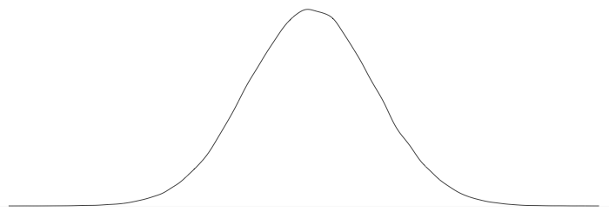
Time
Notes:
If you would repeat this multiple times, get normal distribution.

Slide 16
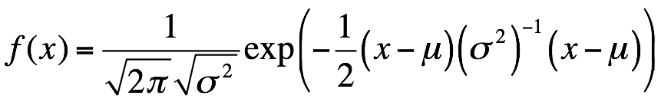
dnorm(x, mean = μ, sd = σ)
Notes:
Plug and chug to get likelihood of data. What are free parameters here?

Slide 17
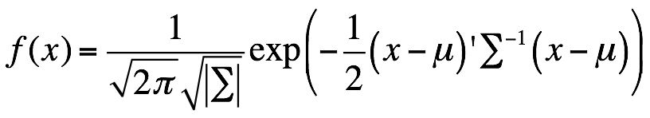
Notes:
That works for a single branch. For multiple branches, need multivariate normal.

Slide 18
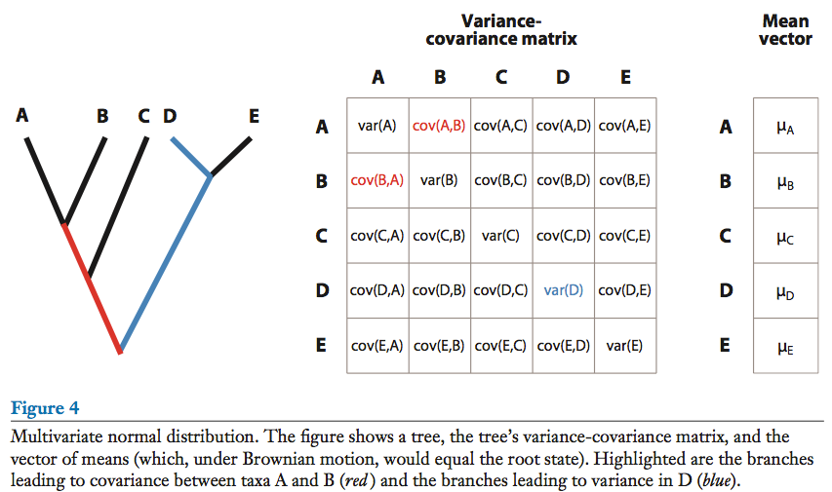
Notes:
the summation is just this matrix

Slide 19
Key properties of Brownian motion
Variance is rate multiplied by time (root to tip length)
Covariance is rate multiplied by shared time (root to MRCA length)
Trait mean is value at the root.

Slide 20
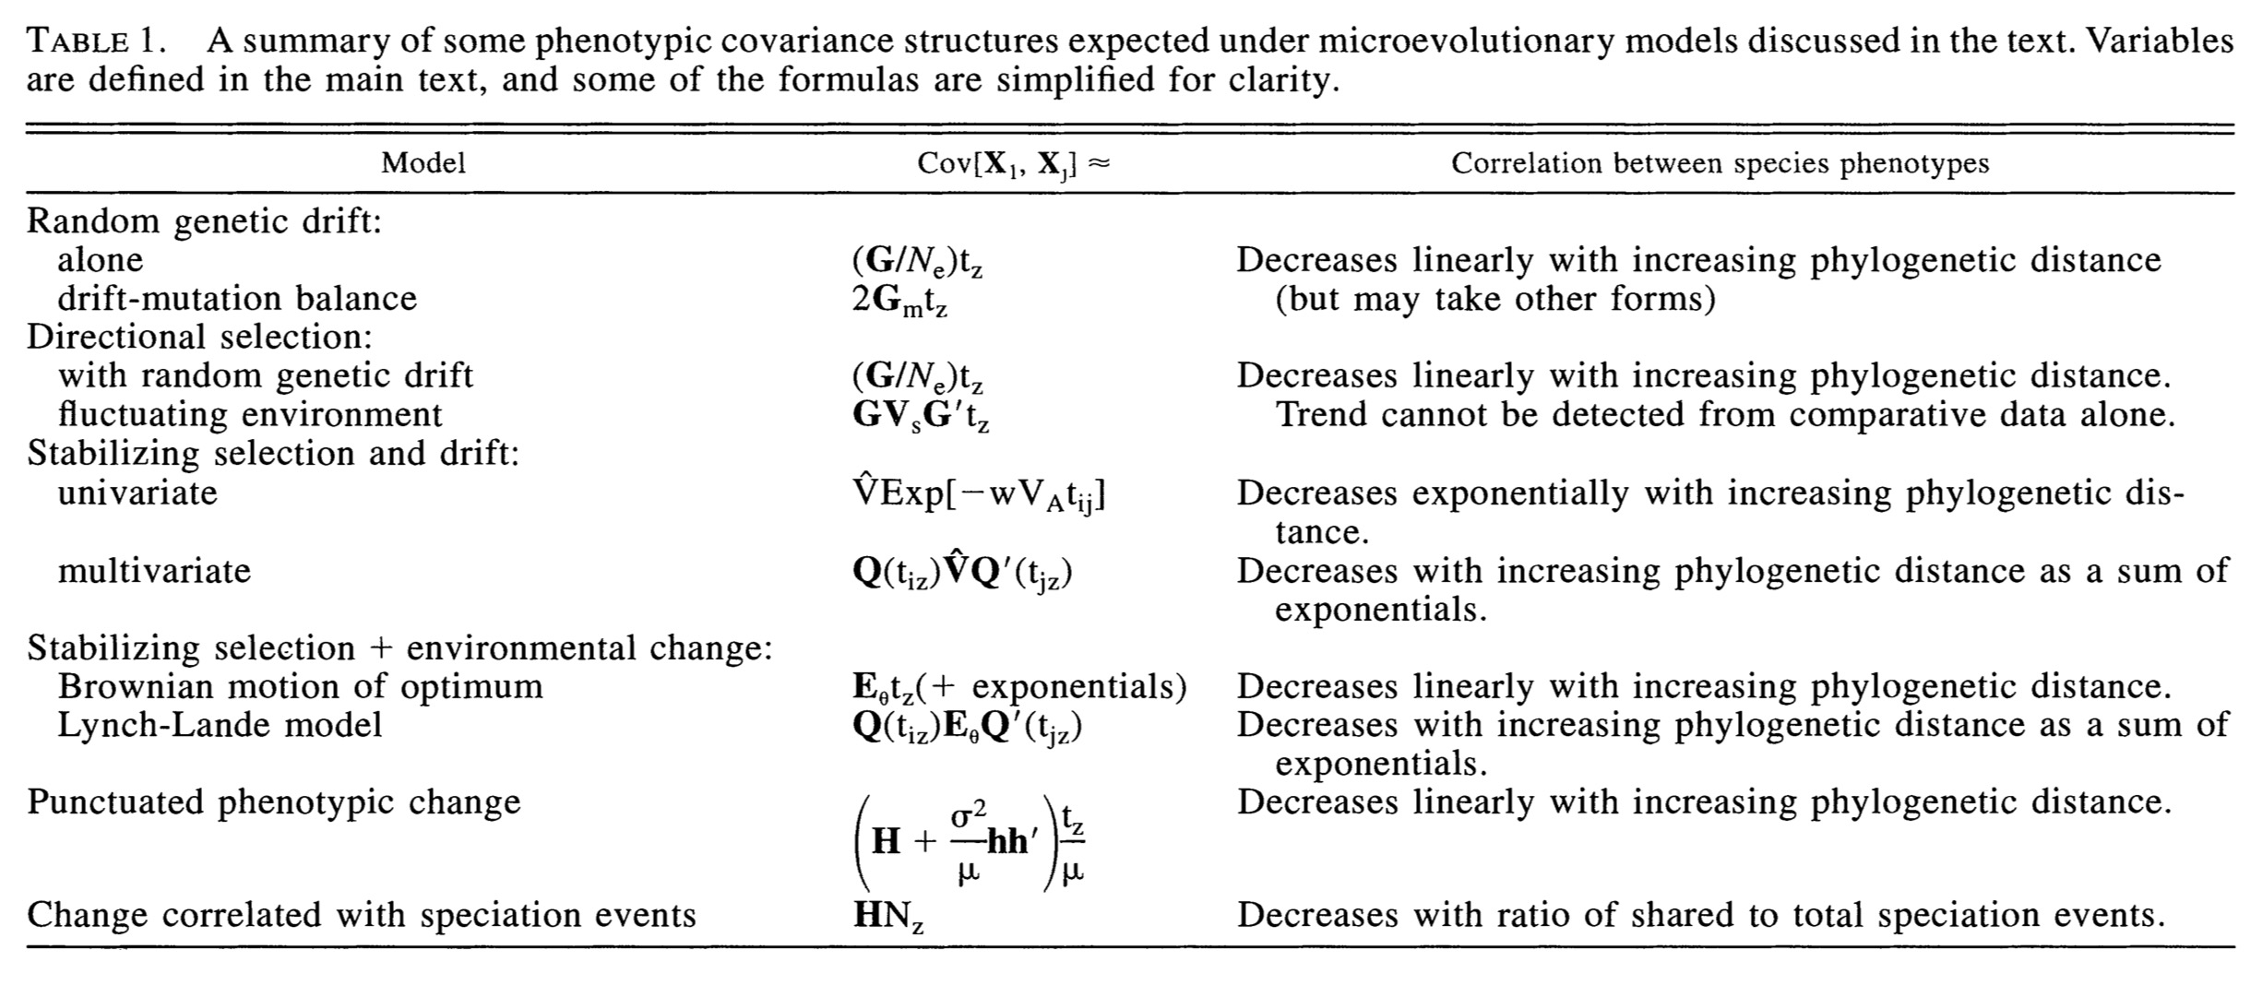
Hansen & Martins 1996

Slide 21
👎
👎
👎
🤷

Slide 22
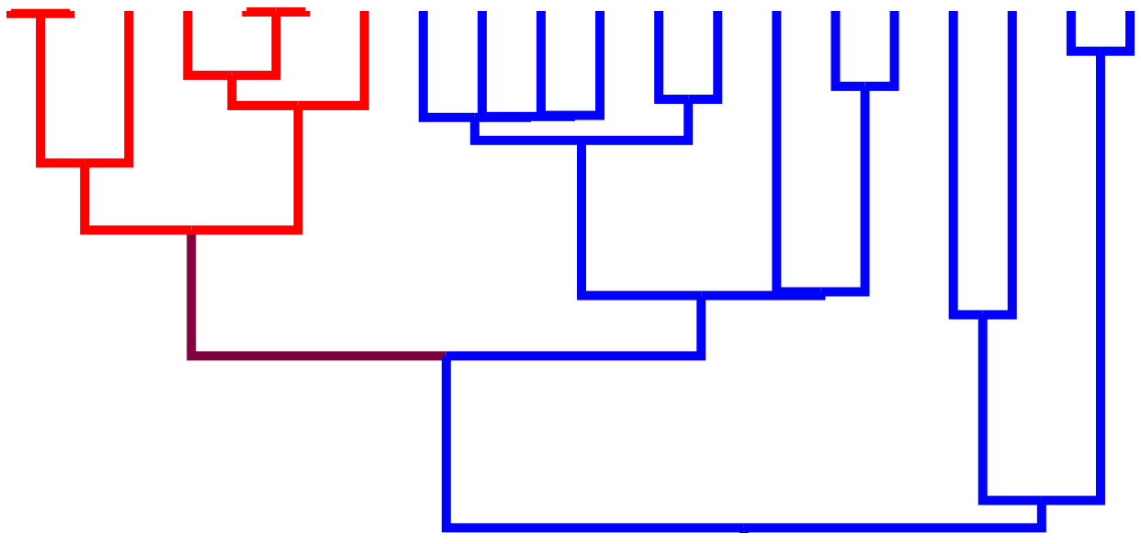
Model 1: Rate A = Rate B
Model 2: Rate A, Rate B may vary
Notes:
It becomes harder to know where to assign rates if there's homoplasy in the discrete character

Slide 23
Model 1: Rate A = Rate B
Model 2: Rate A, Rate B is smaller than Rate A
Notes:
Can assign regimes.

Slide 24
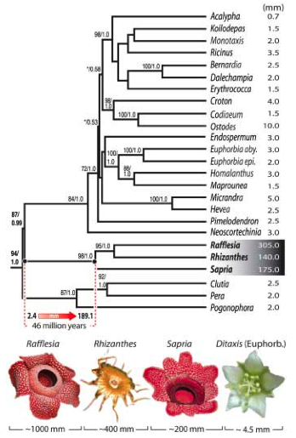
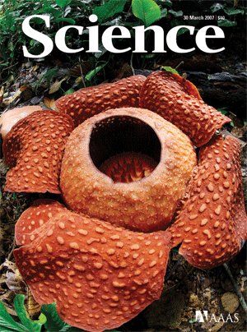
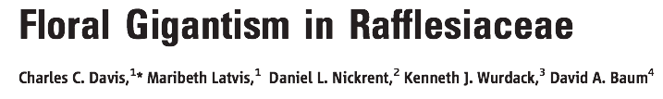
Estimate rates A, B, and C
Stretch tree based on these rates
Estimate states on stretched tree
Notes:
They used Brownie to get optimal rate estimates, then used these to scale the tree and then estimate ancestral flower sizes.
(trait – flower diameter – on log scale)

Slide 25
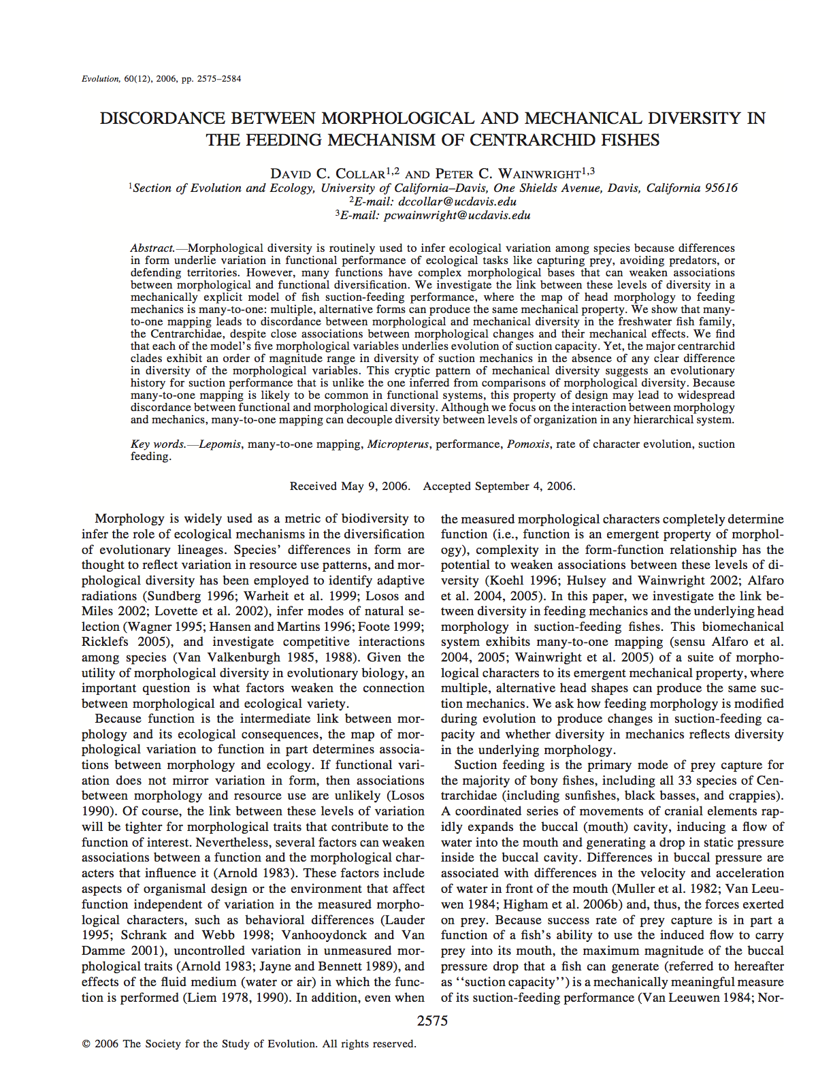
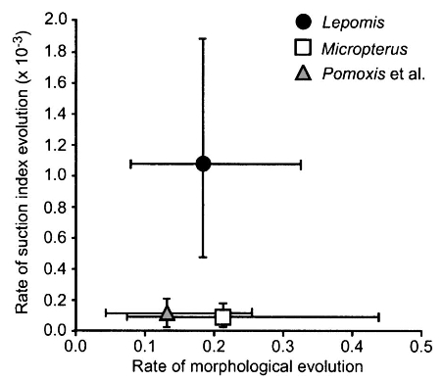
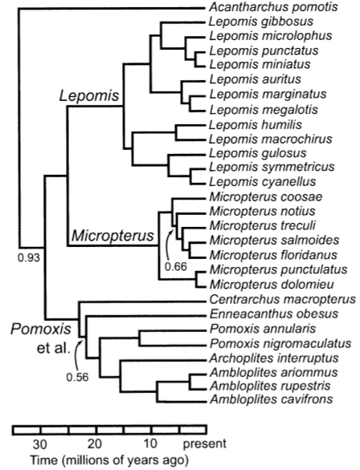
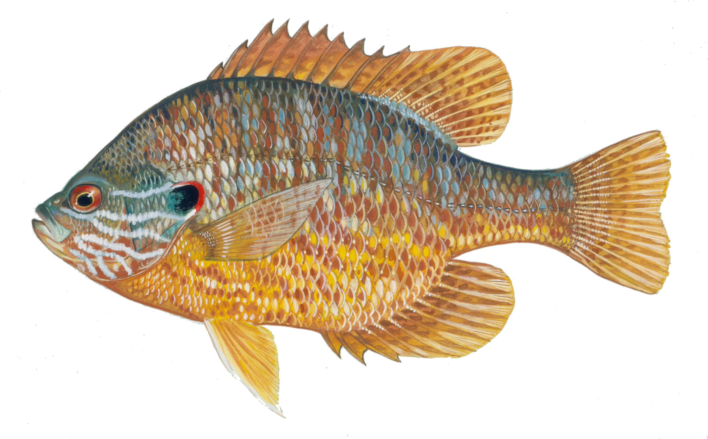
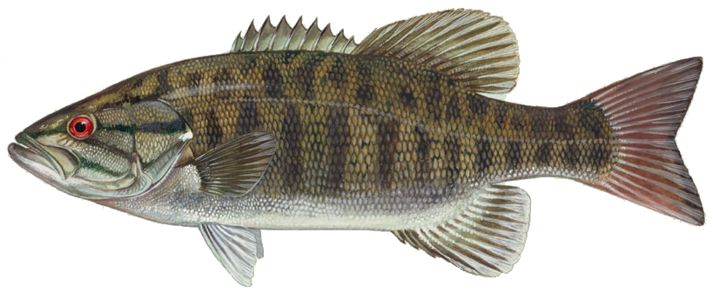
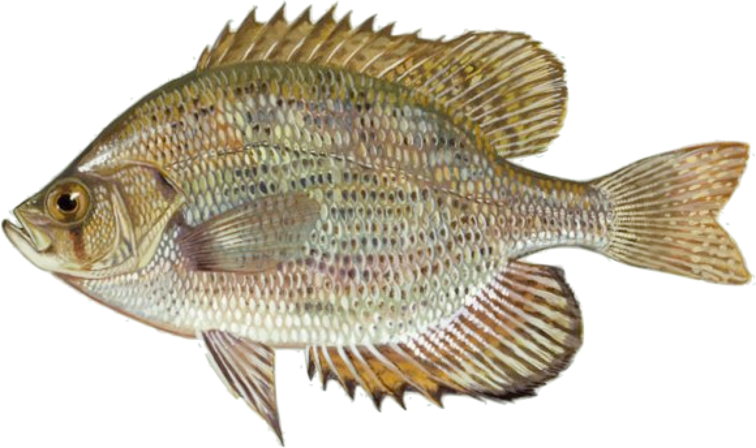
US FWS
Notes:
The censored approach has been used by Dave Collar (a Losos postdoc) to investigate morphological evolution. All three fish clades have similar rates of morphological evolution in general, but sunfishes have a much higher rate of evolution of their feeding apparatus (which is interesting, as they also have a greater diet diversity).

Slide 26
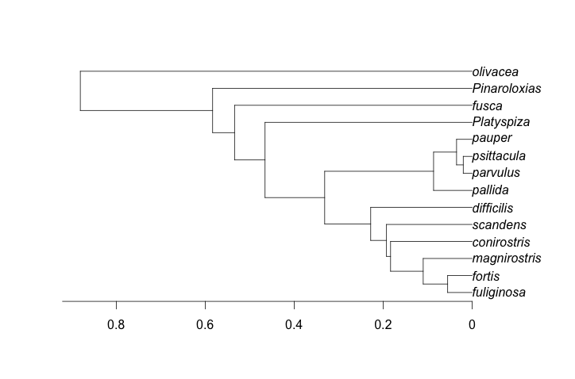
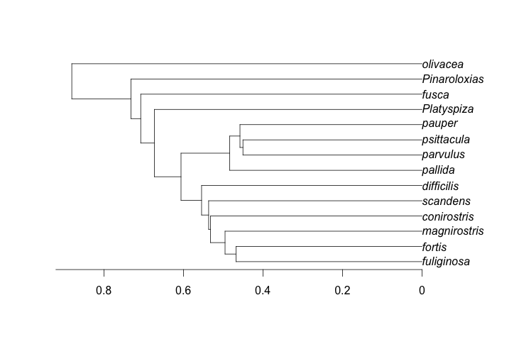
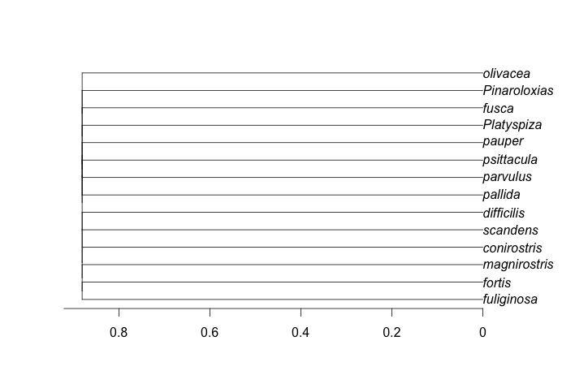
Lambda = multiply internal branch lengths
1
0.5
0

Slide 27
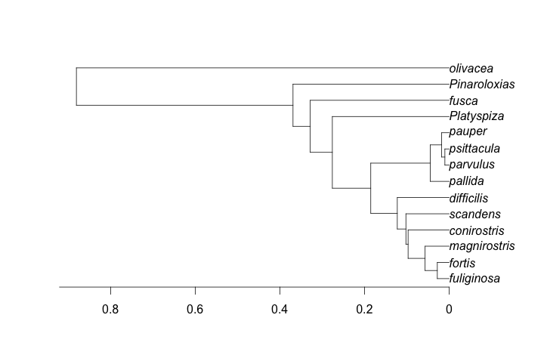
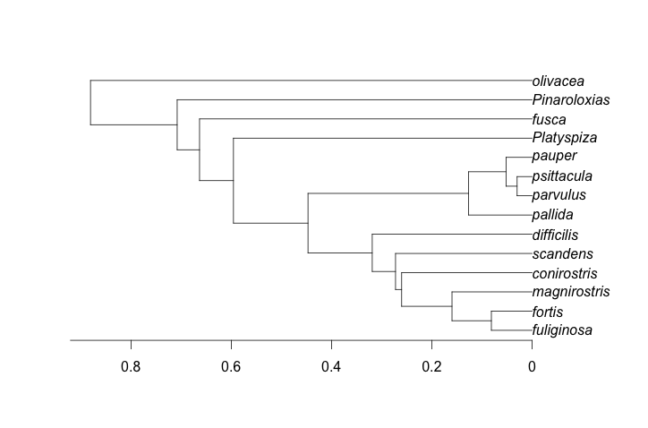
Delta = speed up or slow down
0.5
1
1.5

Slide 28
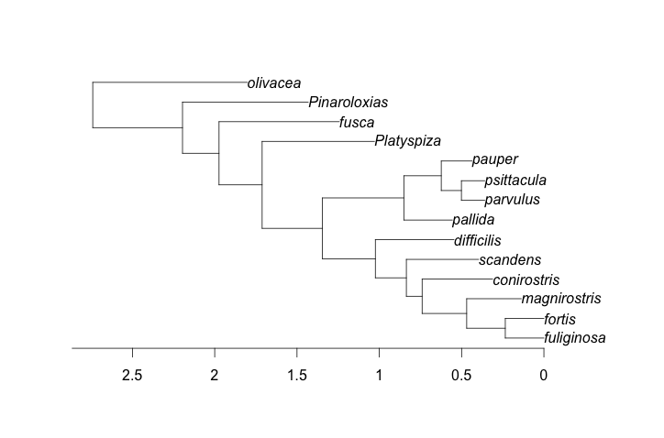
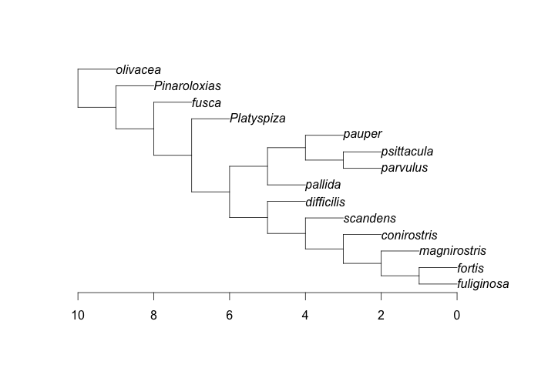
Kappa = raise each branch to kappa. Punctuational models.
1
0.5
0
Notes:
Why scale branch lengths/ brownian rate change:
Selection on a trait, mutation rate…

Slide 29
Caveats
Branch lengths matter a LOT when looking at heterogeneity. Variance is rate x time, so we just stretch the tree – however, if the tree branch lengths are off systematically, then the rates will be off, too.
Measurement error matters too: it looks like extra variance at the tips. It’s easy to incorporate in these models, but almost no-one does (and everyone should).
If you assign rate categories according to a character reconstruction, that can be wrong: making rates more similar than they should be.
Units matter!
Notes:
Units matter – (log) scale them!
Instead of clock time: may want # generations as branch length

Slide 30
If you want to do this
R: OUwie: BM1, BMS models in OUwie()
R: phytools: brownie.lite()
Dedicated app: Brownie (C++)
Plus, many approaches that scale branch lengths, stretching trees in various ways (FitContinuous in geiger, continuous traits in BAMM, etc.) are essentially doing this: stretching the branch lengths is changing the Brownian motion rate on that part of the tree.
Notes:
Hopefully only one of a set of topologies are true
Brownian motion – topologies that are wrong will tend to overestimate rate of brownian evolution
How much movement do you need to explain your existing phenotypic distribution? If the fit is bad, need lots of brownian movement to explain the phylogeny.

